Slide 1
Bias in Artificial Intelligence
Lt Col Hiren Patel, PhD
AFIT/LSS
Notes:
Hello everyone. I’m really glad to be talking about this topic.
If anyone has questions along the way, please feel free to interrupt me. Also, I need to state up front that I’m not an expert in this subject, but interested in it and I’ve worked with experts in this field. So please still ask questions, but we might have to come up with answers as a team.
So this brief is a really a bunch of different lists: AI Ethical Issues, Types of Bias, and lists of solutions. The Kaggle tutorial website and research papers in the invite has all of this so no need to memorize. I'll cover each very briefly so we have time to converse.

Slide 2

Notes:
So if that didn’t come across well, I’ll include these slides in the Teams chat afterward and you can watch it again.
The speaker outlines that there is so much focus on when AI will overcome human strength – when will AI be better than humans, in decision making, in memory, in doing things better than humans do.
But we didn’t realize along the way that there is a much earlier date when AI overcame human weakness. He argues that this day passed us years ago, and we’re seeing all kinds of negative effects right now, in polarization, lack of trust, lack of civility, and less human connectedness.
(Optional) The "like" buttons on social media – they aren't there to give us a dopamine hit when our friends like our post. They provide the social media companies with a metric to gauge which posts are more popular than others, the rate of popularity --> and their algorithms then use that info to determine what to prioritize for sharing.

Slide 3
AI Ethical Issues
Intentional Harm
Trust
Security
Opacity
Bias
Notes:
So let's start with the wide variety of ethical issues with AI. I’ll describe some here briefly, and then focus on one – Bias
In all of these examples, they may not start out intending harm, but I cover the extreme cases.

Slide 4
AI Ethical Issues
Recommender Systems
Advertising
Extremism
Intentional Harm
Trust
Security
Opacity
Bias
Notes:
Intentional harm is just what it says. It’s using algorithms to influence a desired action. This is the easiest for us to understand.
Companies use recommender systems to get people to click on links or stay on their platforms so they can see more ads.
But when these recommender systems aren’t checked or controlled, they can lead people down the extreme corners of society.
This is what the book “weapons of Math Destruction” and “the social dilemma” movie are about.

Slide 5
AI Ethical Issues
Intentional Harm
Trust
Security
Opacity
Bias
Trusting that an AI model will do what it was designed to do… and nothing else
Notes:
Trust in AI – believing that an AI system will do what it was designed to do, and nothing else. I think that speaks for itself.

Slide 6
AI Ethical Issues
Intentional Harm
Trust
Security
Opacity
Bias
Are models secure against attack and subversion
Notes:
Security – also a topic that DOD members are familiar with generally. When applied to algorithms, you want to make sure they are secure so that they are predicting outcomes as intended.
There’s a lot of cat-and-mouse research out there on how to cause models to drift so that they start making wrong predictions, and then how to prevent that.

Slide 7
AI Ethical Issues
Intentional Harm
Trust
Security
Opacity
Bias
Easy to understand or black box?
Notes:
Opacity – This is about how transparent or opaque models are. Are they easy to understand how they are learning, or are they hopelessly complicated.
More complicated models have been making better predictions, but then we have to give up more control. This also makes it harder to find out what went wrong when they start mis-predicting.

Slide 8
AI Ethical Issues
Intentional Harm
Trust
Security
Opacity
Bias
Biased to artificially favor a group or outcome
Notes:
Finally, Bias – When an AI model’s outcomes favor a particular group or outcome unfairly, we say there is bias in the model.

Slide 9
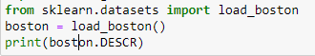
Boston Housing Data
Notes:
Let’s go over a real world use case that highlights historical bias and how it can affect future predictions.
I was going through a Python machine learning course on Udemy and the exercise said to load the Boston Housing Dataset
This is a standard dataset that's preferred for teaching linear regression because it’s complete, has a variety of variables and leads to a good fit.
It uses Census data from 1970 and is often used to predict what the median cost of house should be given a number of variables.
Think of this as a precursor to the Zillow home value predictor. So after the model learns how various factors are related to a median house price, it can be used to predict future home prices.

Slide 10
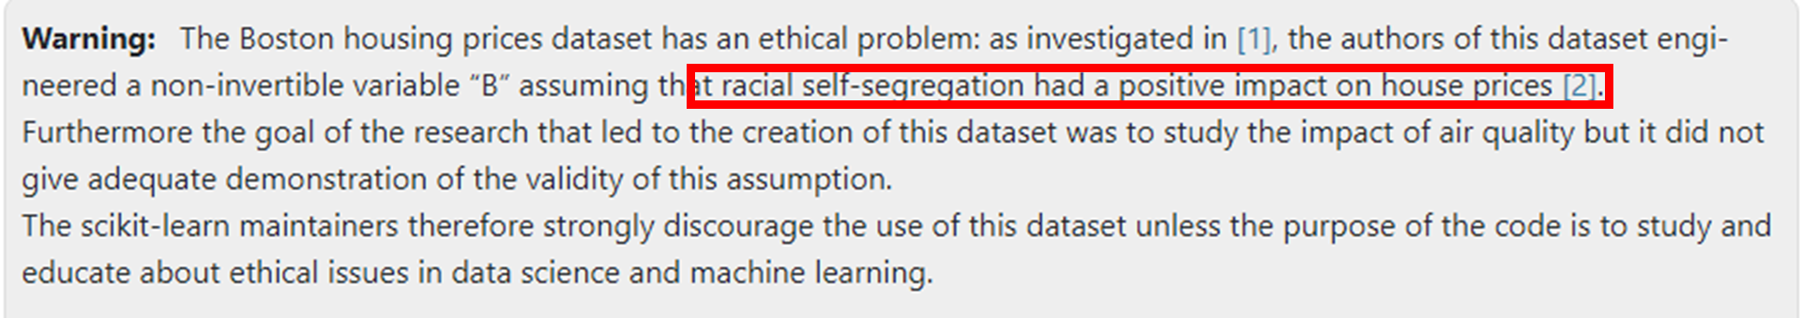
Boston Housing Data
Notes:
However, when I ran the code, I saw this warning. And I was curious so I decided to find out more.
Now many studies take race into account during analysis. But here, the authors engineered a new variable and made assumptions that were wrong and based on prior bias.
This is a classic example of Historical bias. Home prices were significantly lower in areas with higher African Americans populations because of decades of redlining, where whole neighborhoods were ignored by the FHA and lenders, leading to dramatically lower housing prices.
- The true crime here is that the linear regression model built with this data will learn this redlining effect and perpetuate it when it determines how to predict home prices in the future based on proportions of African Americans in the area.

Slide 11
Boston Housing Data
B = 1000(Bk – 0.63)^2
Incorrect Assumption
0-63%: negative relation between Bk and home price
63%+ there is a positive relation
Incorrect Assumption
Parabolic relationship between Bk and home price
Notes:
So here is the actual transformation of the variable. Bk is the percentage of African Americans in the neighborhood of the house.
Authors stated that at proportions from 0-63%, house prices decreased as the proportion of African American home owners in the region increased. Authors assumed this was due to hostility against them from their white neighbors
After the threshold, they said that home values increased when B increased. Authors concluded then that African Americans were “self-segregating” on purpose because this was having a positive impact on their housing prices.
However, subsequent research by other researchers showed that this 0.63 number was not grounded in fact.
Also, there is no evidence that the parabolic relationship exists. The original authors made faulty assumptions without knowing the subjects they were analyzing
Now on its face a lot of this is appalling today, but it was written in the 1970s and was unchallenged for a long time.
Further this is a classic example of Historical bias. Home prices were significantly lower in areas with higher African Americans populations because of decades of redlining, where whole neighborhoods were ignored by the FHA and lenders, leading to dramatically lower housing prices.
- The true crime here is that the linear regression model built with this data will learn this redlining effect and perpetuate it when it determines how to predict home prices in the future based on proportions of African Americans in the area.

Slide 12
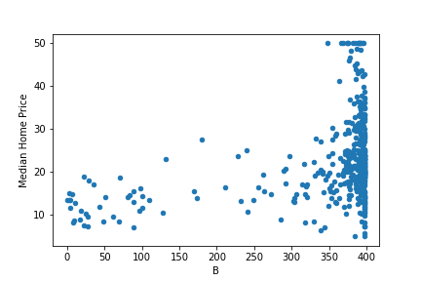
Boston Housing Data
Notes:
Bk is the proportion of African Americans in a given regions around the home. The transformed Bk to B via 1000(B_k - 0.63)^2. While they perform this parabolic transformation, they don’t prove that the relationship between B and the median home price is indeed parabolic. In addition, there is no clear evidence that other researchers have found for justifying the 63% threshold in the equation. So they’re rationalizing things without evidence.
Further in terms of what we’ve learned on bias in AI, this is a classic example of Historical bias. Home prices were significantly lower in areas of higher proportions of African Americans because of decades of redlining, where whole neighborhoods were ignored by the FHA and lenders, leading to dramatically lower housing prices. The true crime here is that the linear regression model built with this data will learn this redlining effect and perpetuate it when it determines how to predict home prices in the future based on proportions of African Americans in the area.

Slide 13
Types of AI Bias
Historical Bias
Representation Bias
Measurement Bias
Aggregation Bias
Evaluation Bias
Deployment Bias
Notes:
I think the best way to describe bias is by going over the different types and examples.
For all of this following information, there’s a course on the website Kaggle.com on AI ethics, where they also have published sources if you want to delve deeper. I've also cited them in the notes section of these slides.
Source: Suresh, Harini, and John Guttag. "A framework for understanding sources of harm throughout the machine learning life cycle." Equity and access in algorithms, mechanisms, and optimization. 2021. 1-9.

Slide 14

Historical Bias
Notes:
Historical bias involves feeding the model data that is tainted by historical bias. The model then makes biased predictions of future events.
So for example, there is a historical bias toward promoting men at faster rates than women. This is not correct, but we see it in the historical data.
Then a model that learns on this data doesn’t know it’s incorrect, and it learns that men are superior workers than women. So if this model is a resume-screener, it will start rejecting female applicants.
I’ll show later an example of redlining on this topic.
Source: Suresh, Harini, and John Guttag. "A framework for understanding sources of harm throughout the machine learning life cycle." Equity and access in algorithms, mechanisms, and optimization. 2021. 1-9.

Slide 15
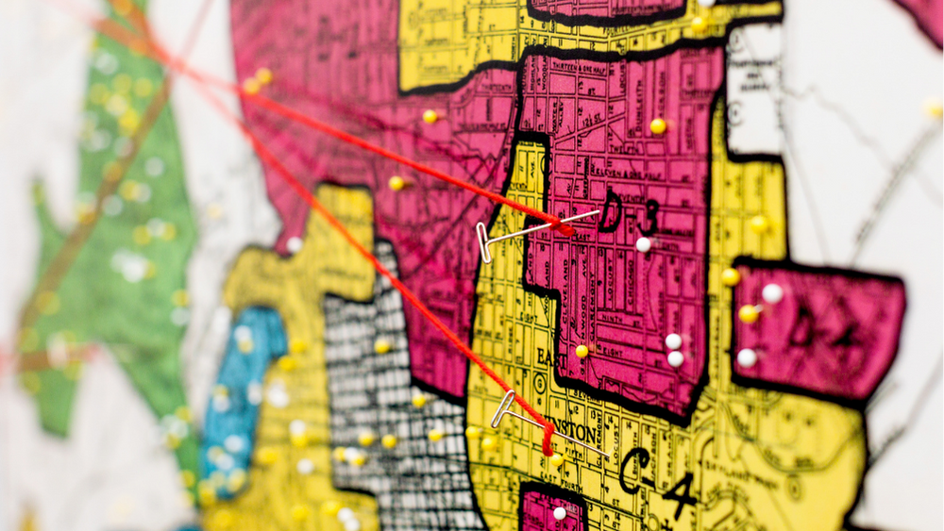
Historical Bias
Notes:
Historical bias involves feeding the model data that is tainted by historical bias. The model then makes biased predictions of future events.
So for our previous example of training a model on redlining --> future predictions will then be biased too.
There is a another example of historical bias toward promoting men at faster rates than women. This is not correct, but we see it in the historical data.
Then a model that learns on this data doesn’t know it’s incorrect, and it learns that men are superior workers than women. So if this model is a resume-screener, it will start rejecting female applicants.
This happened with Amazon in 2014
Source: Suresh, Harini, and John Guttag. "A framework for understanding sources of harm throughout the machine learning life cycle." Equity and access in algorithms, mechanisms, and optimization. 2021. 1-9.

Slide 16
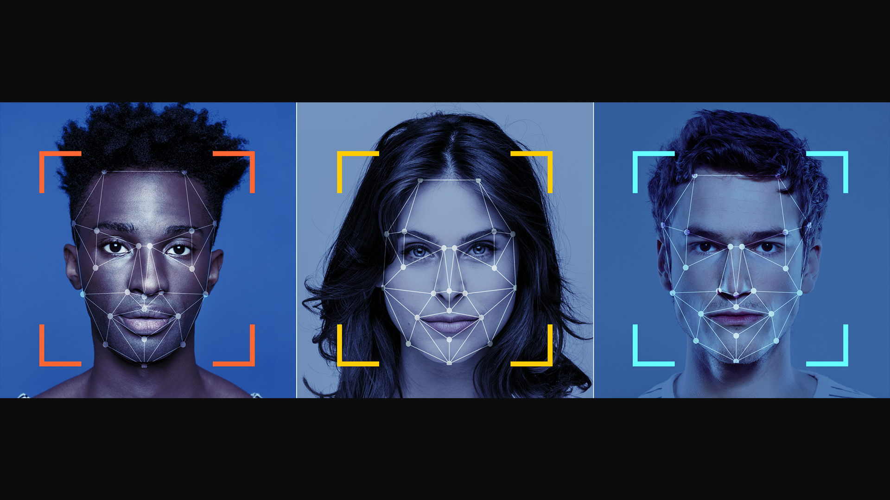
Representation Bias
Notes:
Representation Bias – this is where one group in the training data is over-represented. The model then will become more accurate for that group than the others. It will then have a lower accuracy rate for the other groups which can lead to real-world consequences.
A facial recognition model at an airport might start incorrectly flagging minority faces for further screening.
Source: Suresh, Harini, and John Guttag. "A framework for understanding sources of harm throughout the machine learning life cycle." Equity and access in algorithms, mechanisms, and optimization. 2021. 1-9.

Slide 17

Measurement Bias
Notes:
Many people are familiar with the game of telephone. One kid starts by whispering a sentence in the ear of another who then repeats it down the line. By the time the last person hears the sentence it might be totally different. What happened? We compounded errors each step along the way.
Measurement bias occurs when the data for certain groups is not measured directly but through a proxy. For example, if non-native speakers need a translator before going through a natural language processing model, then that introduces a possibility of additional error in that measurement, leading to worse outcomes for that group.
Source: Suresh, Harini, and John Guttag. "A framework for understanding sources of harm throughout the machine learning life cycle." Equity and access in algorithms, mechanisms, and optimization. 2021. 1-9.

Slide 18

Aggregation Bias
Notes:
This happens when we are not differentiating for race, sex, etc., for example when studying health outcomes. We saw this during the pandemic. You can certainly say what the COVID outcomes have been for the population at large, but then dive deeper to see if there are more adverse outcomes for minority members. So when you make your action plans, you base that on these nuances.
Source: Suresh, Harini, and John Guttag. "A framework for understanding sources of harm throughout the machine learning life cycle." Equity and access in algorithms, mechanisms, and optimization. 2021. 1-9.

Slide 19
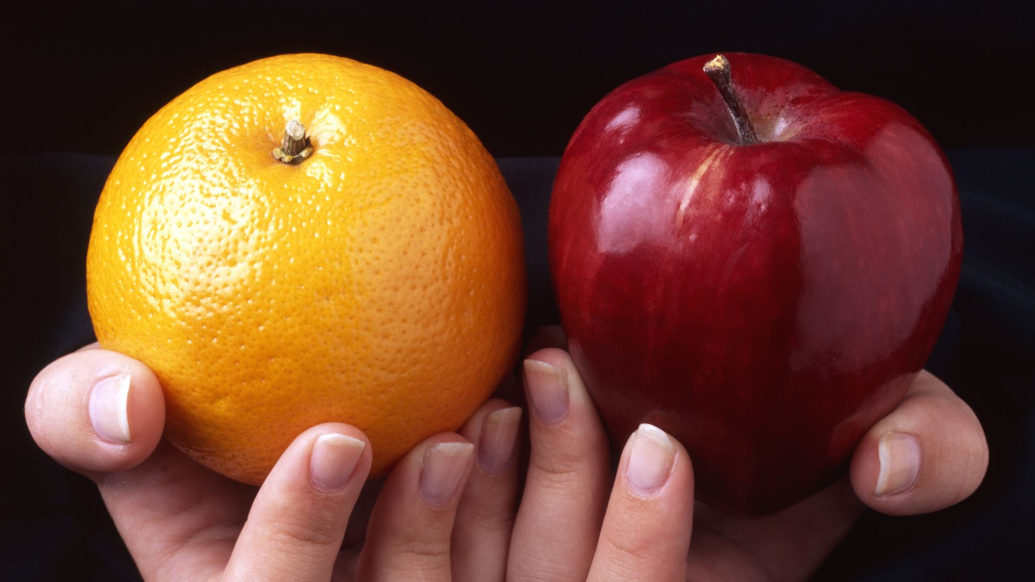
Evaluation Bias and Deployment Bias
Notes:
After building a model, data scientists should test it. If we use a test set of data that is not representative of the population, then we’re likely to have false results of how accurate our model is. And we’re likely to optimize the model based on this non-representative set.
Deployment bias is using a dataset for a purpose that it wasn't built for. For example, say the police use a crime statistic model to determine where and when crime trends are going up. This helps them determine where to step up their patrols. Now what if a judge also uses that model when determining guilt or sentencing? A prediction from the previous model is not an admission of guilt for everyone that was in the particular area at a certain time. So the judge might give out a harsher sentence or tend toward judging a person guilty.
(Optional) This is especially important as we see more adoption of transformer models such as with NVidia. They provide basic translation models that can then be adapted for other uses or other languages. When you do this, you want to be careful you're not creating a deployment bias.
Source: Suresh, Harini, and John Guttag. "A framework for understanding sources of harm throughout the machine learning life cycle." Equity and access in algorithms, mechanisms, and optimization. 2021. 1-9.

Slide 20

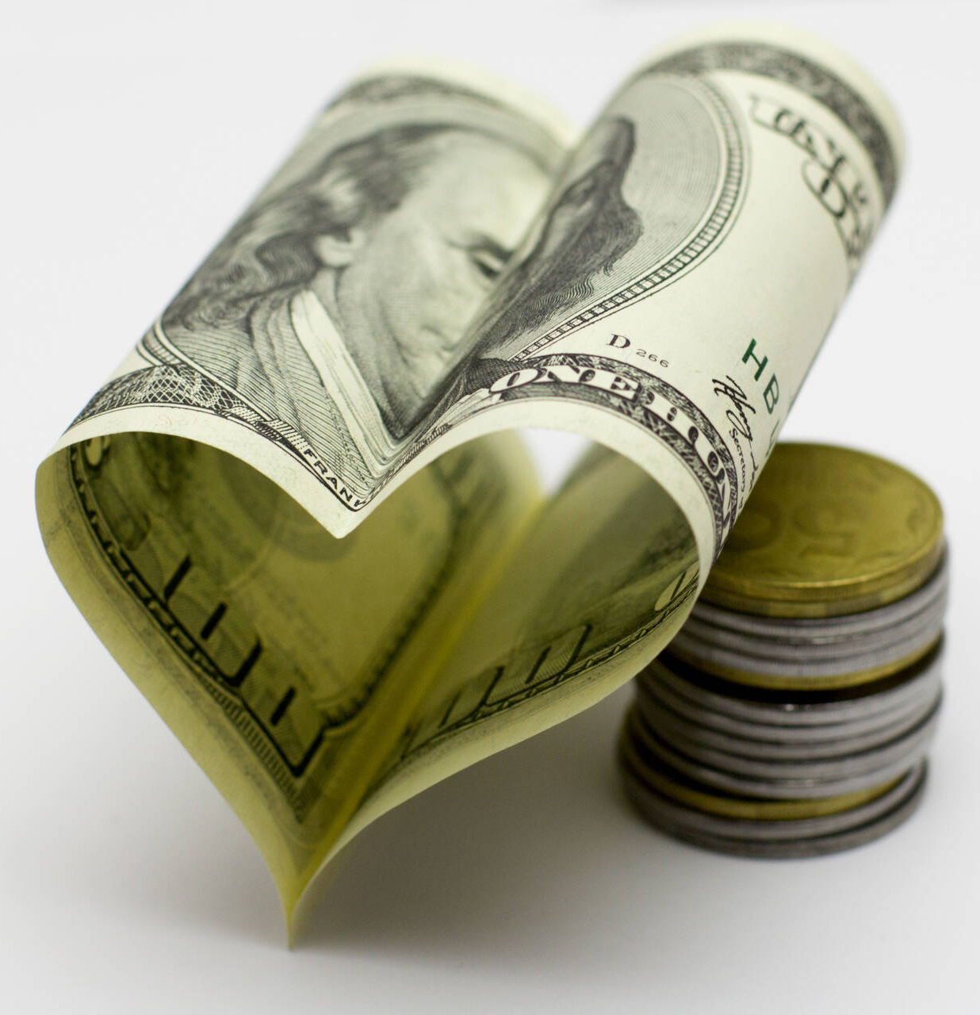

The "So What" Factor
Notes:
There are so many ways in which bias in AI models can be costly.
Security Loss
Imagine a facial recognition software incorrectly identifying threats because of Representation Bias
Credible threat not found in under-represented populations
Innocent people detained and harassed
Financial Loss
Obviously if your algorithms are biased, you’re missing out on the part of the population that is not represented.
If your resume screener rejects very qualified female or minority applicants, you could miss out on the next great leader
Reputation Loss
This is very important to the military
We enjoy a very high favorability rating among the public
Even unintended bias through algorithms is big news and can sour our reputation. Leads to lack of trust in our government institutions.

Slide 21
Solutions
US Government Response
Researcher Response
AFIT Response

Slide 22

Government Response
AI.gov
NIST | DOD | FTC | FCC
Intel Community | NSF | CFPB | USAID
Notes:
The federal government has started a number of initiatives in an effort to ensure AI is developed ethically.
Your main source is AI.gov. There's a section there on Advancing Ethical AI that has links to many Agency's and Department's ethical AI policies.
For example, NIST is developing a Risk Mitigation Framework for AI.
The DOD has Ethical Principals of AI
FTC issued business guidance on AI and algorithms
CFPB issued a circular to creditors using AI algorithms that they have to disclose the specific principal reasons for taking action on adverse action such as denying credit
SHOW THE WEBSITE

Slide 23
General Research Guidelines
Human Centered Design (HCD)
Understand people’s needs to define the problem
Ask if AI adds value to any potential solution
Consider the potential harms that the AI system could cause
Prototype, starting with non-AI solutions
Provide ways for people to challenge the system
Build in safety measures
Notes:
Generally speaking, you can prevent or reduce bias in your models by taking a Human Centered Design approach to your algorithms
First let's try to understand the people for whom you're building an algorithm.
Such as in our redlining example for Boston – the authors didn't know the people in those districts or the history.
Know the customer's pain points before trying to solve them

Slide 24
General Research Guidelines
Human Centered Design (HCD)
Understand people’s needs to define the problem
Ask if AI adds value to any potential solution
Consider the potential harms that the AI system could cause
Prototype, starting with non-AI solutions
Provide ways for people to challenge the system
Build in safety measures
Notes:
Often times a machine learning algorithm may not be needed. You can get a good solution with a simple state machine or flow chart.
This is much more transparent and you can easily tell how decisions are being made vs in a neural network.

Slide 25
General Research Guidelines
Human Centered Design (HCD)
Understand people’s needs to define the problem
Ask if AI adds value to any potential solution
Consider the potential harms that the AI system could cause
Prototype, starting with non-AI solutions
Provide ways for people to challenge the system
Build in safety measures
Notes:
This is like red-teaming: Ask the "what if" questions and try to determine if there are 2nd or 3rd order effects from implementing this algorithm

Slide 26
General Research Guidelines
Human Centered Design (HCD)
Understand people’s needs to define the problem
Ask if AI adds value to any potential solution
Consider the potential harms that the AI system could cause
Prototype, starting with non-AI solutions
Provide ways for people to challenge the system
Build in safety measures
Notes:
Creating a non-AI prototype for users to interact with might give you some insight on whether it serves the capability gap or if it creates new problems.

Slide 27
General Research Guidelines
Human Centered Design (HCD)
Understand people’s needs to define the problem
Ask if AI adds value to any potential solution
Consider the potential harms that the AI system could cause
Prototype, starting with non-AI solutions
Provide ways for people to challenge the system
Build in safety measures
Notes:
This one is important – Give circuit-breakers for users to flag when the algorithm is not working.
When you have Google News recommending some article to you, if they get it wrong, you can click on the 3 dots and choose "more or less stories like this"

Slide 28
General Research Guidelines
Human Centered Design (HCD)
Understand people’s needs to define the problem
Ask if AI adds value to any potential solution
Consider the potential harms that the AI system could cause
Prototype, starting with non-AI solutions
Provide ways for people to challenge the system
Build in safety measures
Notes:
Keep testing and evaluatiing your algorithm – don't just set it and forget it.

Slide 29
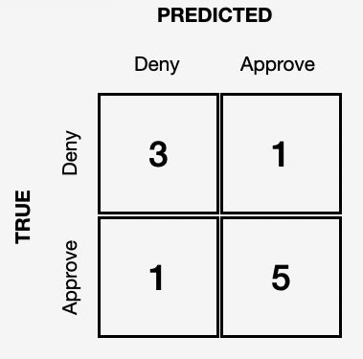
Model Tuning
Notes:
From an AI researcher point of view, there are some ways to tune a model to prevent bias.
Here we have the confusion matrix. Results here show the True Positive, True Negative, False Positive, and False Negative results of a model.

Slide 30
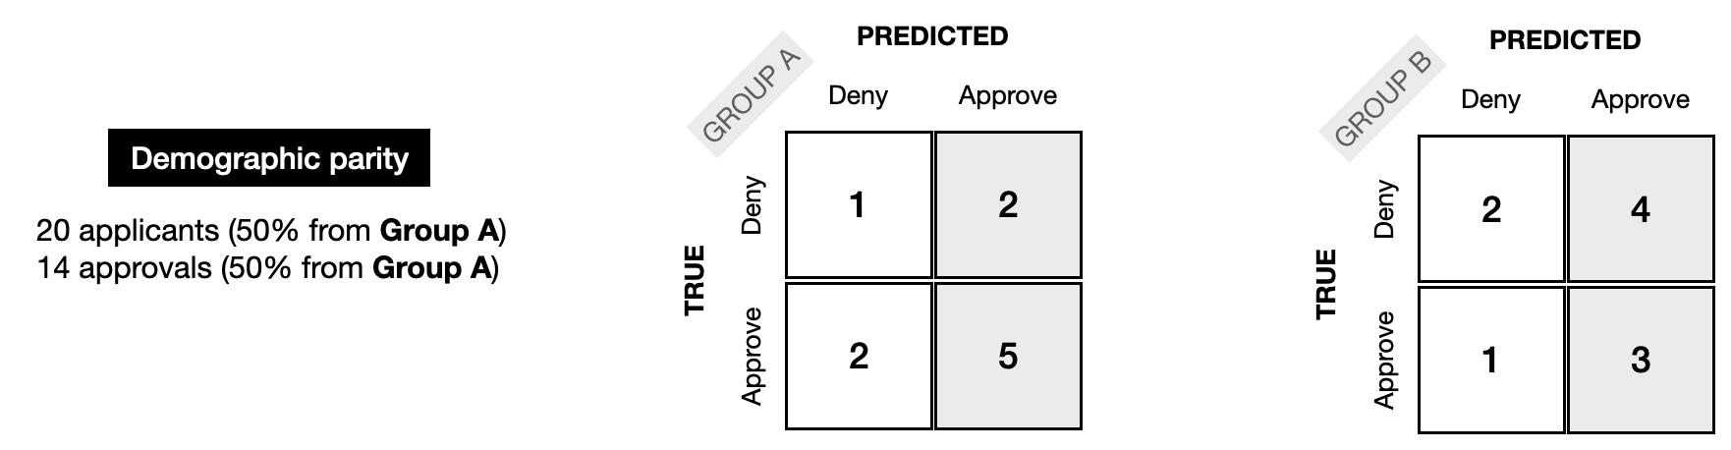
Demographic Parity
Group Percentage of People Selected = Gorup Percentage of Overall Population
Notes:
Demographic/Statistical Parity
the model is fair if the composition of people who are selected by the model matches the group membership percentages of the applicants.
i.e. if the population has 50% women, and the AI model (e.g. resume screener) chooses a subset as it’s output, then the subset should have 50% women
Full example from Kaggle:
A nonprofit is organizing an international conference, and 20,000 people have signed up to attend. The organizers write a ML model to select 100 attendees who could potentially give interesting talks at the conference. Since 50% of the attendees will be women (10,000 out of 20,000), they design the model so that 50% of the selected speaker candidates are women.

Slide 31
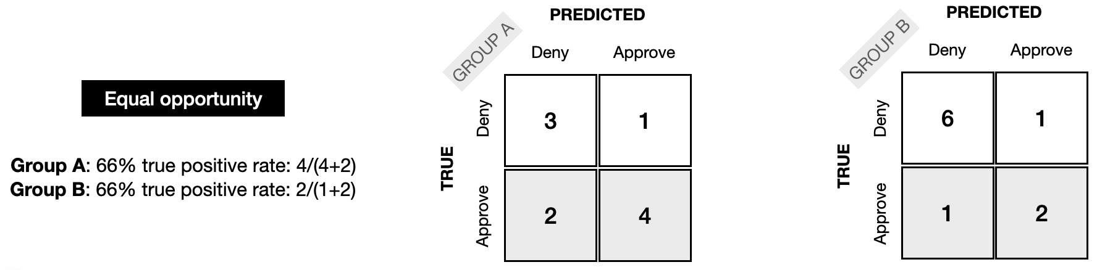
Equal Opportunity
Same true positive rate for both groups
Notes:
Equal Opportunity
the proportion of people who are correctly selected by the model ("positives") is the same for each group.
I.e. true positive rate for the model output is same for each demographic group // meaning that it’s not picking any one group more than all the others
Full Kaggle Example
A doctor uses a tool to identify patients in need of extra care, who could be at risk for developing serious medical conditions. (This tool is used only to supplement the doctor's practice, as a second opinion.) It is designed to have a high TPR that is equal for each demographic group.

Slide 32
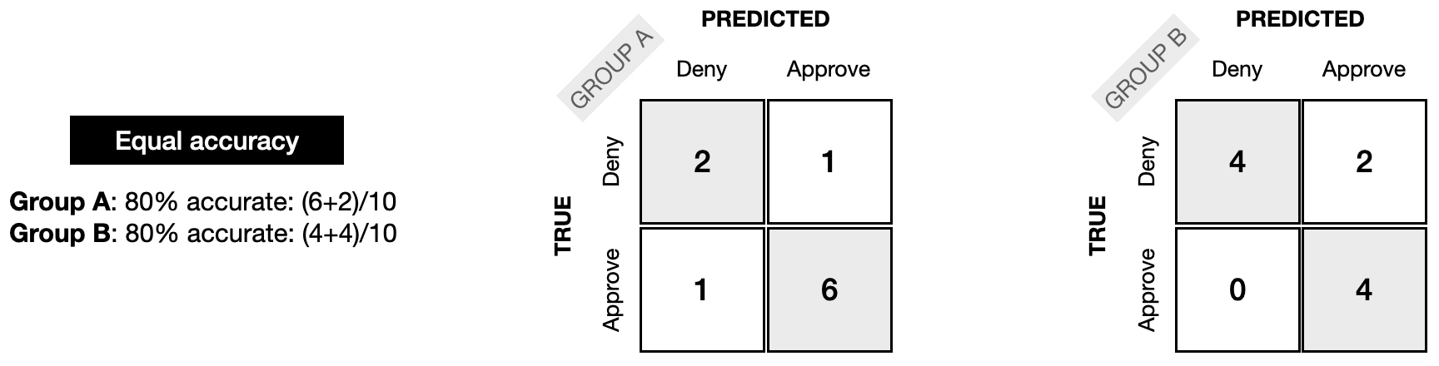
Equal Accuracy
Same model accuracy for both groups
Notes:
Equal Accuracy
Similar to Equal Opportunity, but using the Accuracy model: the percentage of correct classifications (people who should be denied and are denied, and people who should be approved who are approved) should be the same for each group.
Full Kaggle Example
A bank uses a model to approve people for a loan. The model is designed to be equally accurate for each demographic group: this way, the bank avoids approving people who should be rejected (which would be financially damaging for both the applicant and the bank) and avoid rejecting people who should be approved (which would be a failed opportunity for the applicant and reduce the bank's revenue).

Slide 33
What Can AFIT Do?
Researchers
Tune Models
Human Centered Design
Highlight in research papers
Professors
Notes:
So there are a number of easy steps we can take to make sure we're complying with DOD policy and remaining unbiased:
- For the researchers, when you're developing models in experiments for future publication, make sure you include a small section in your journal article outlining how you've checked for bias
- with all the attention in government and industry on this subject, this should be a benefit in getting you published.
- I've stated several ways to tune your models to reduce bias – use those
- For any model that will be deployed to real world situations, ensure you've taken steps for human centered design
- you've included or recommended places for circuit breakers where users can provide feedback if the model is not behaving correctly.
- For professors, when you're sitting in defenses, expect the student to outline how they've checked for model bias and if they've tuned their models for that

Slide 34
Questions?

